Slide 1


3 Stars Auto Garage
We sell cars faster than your ex sold you

Slide 2
Members
Layout designer: Nguyễn Đức Thắng – MSSV: SE130157
Technical support: Trần Quang Minh – MSSV: SE62652
Database designer: Nguyễn Phương Quang – MSSV: SE130190

Slide 3
Introduction
We bring to you the best price and quality of car.
01
Easy to find multiple models of car that you always wanted.
02
Give advices to buy the car that is most suitable for you.
03
Provide place that you can sell your cars with a good price.
04

Slide 4
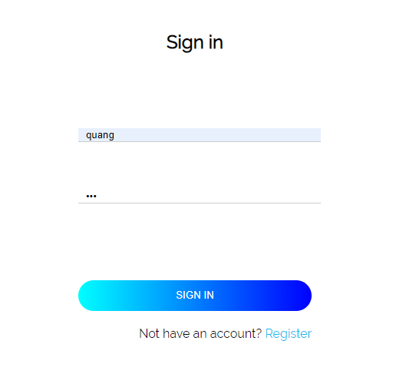
Log In

Slide 5
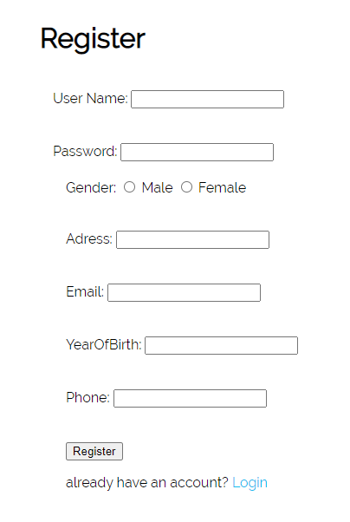
Register

Slide 6
User Layout

Slide 7
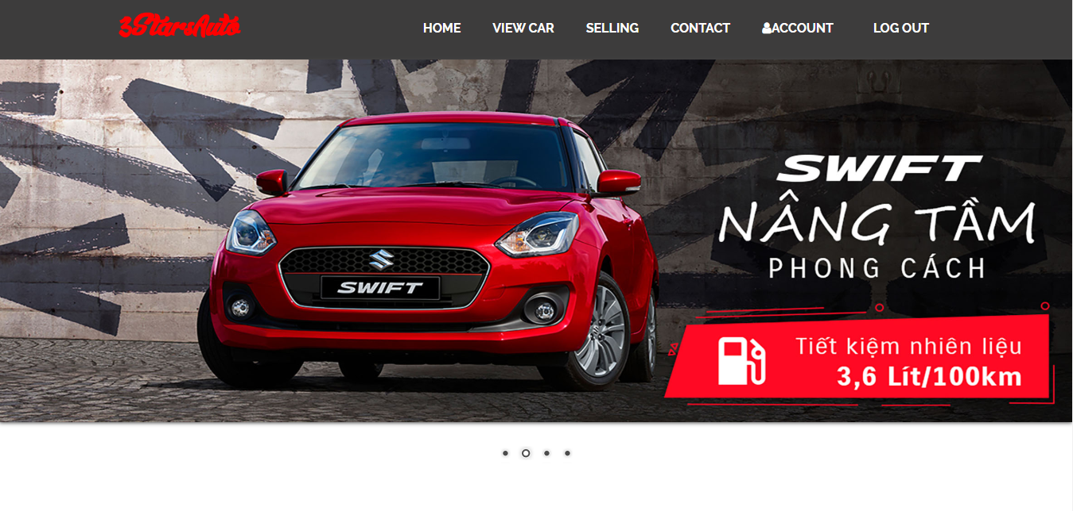
Home

Slide 8
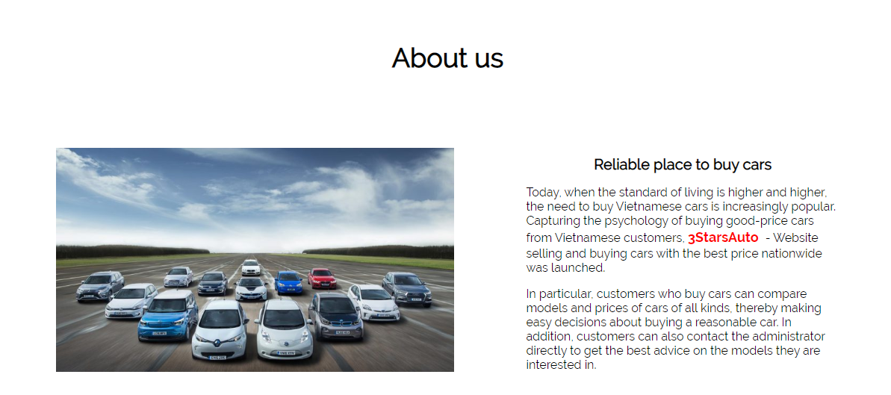
Home

Slide 9
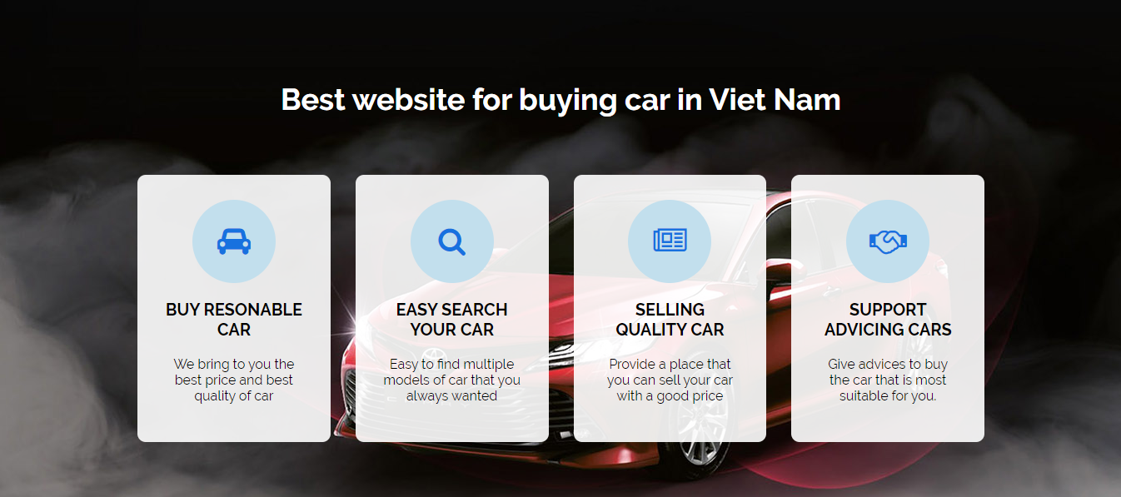
Home

Slide 10
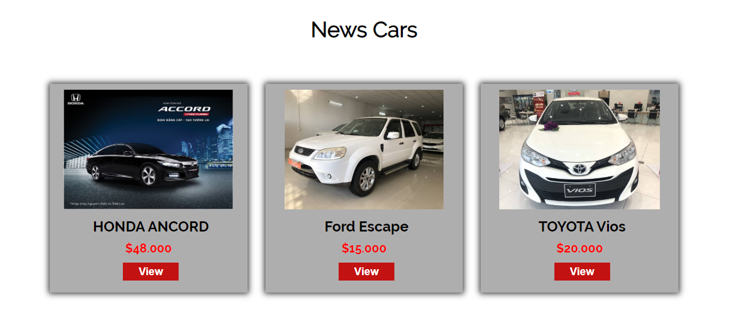
Home

Slide 11

Home

Slide 12
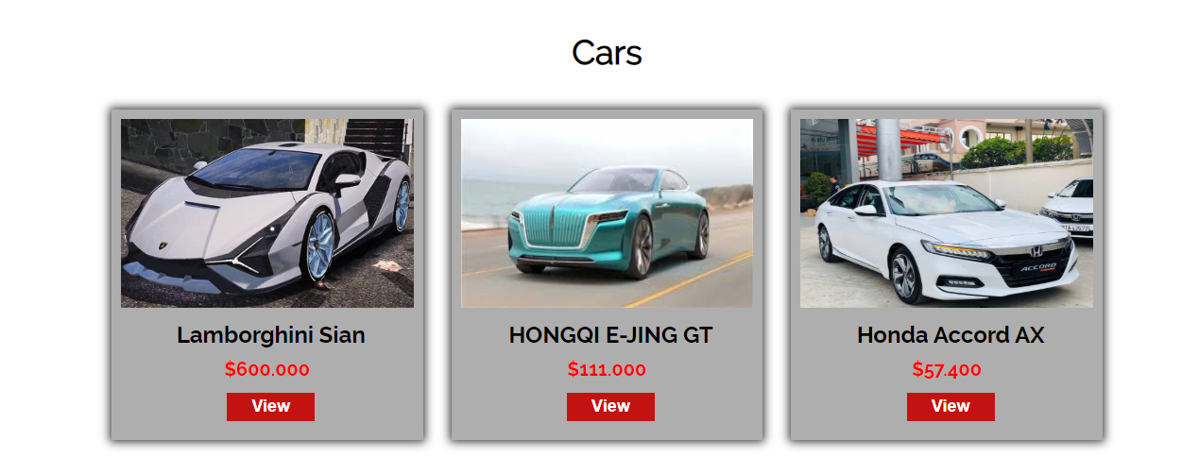
View Cars

Slide 13
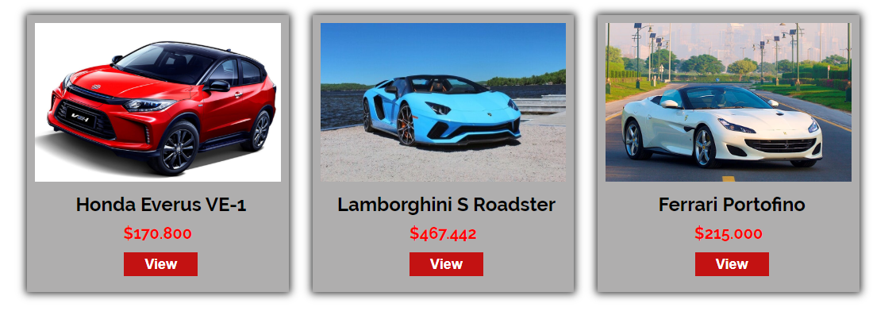
View Cars

Slide 14
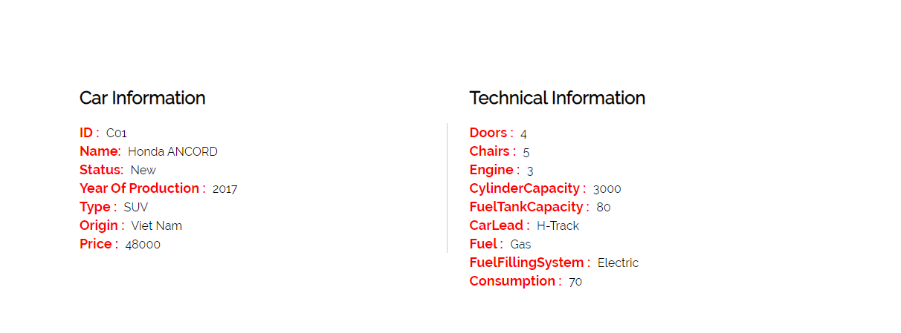
View Car’s Info

Slide 15
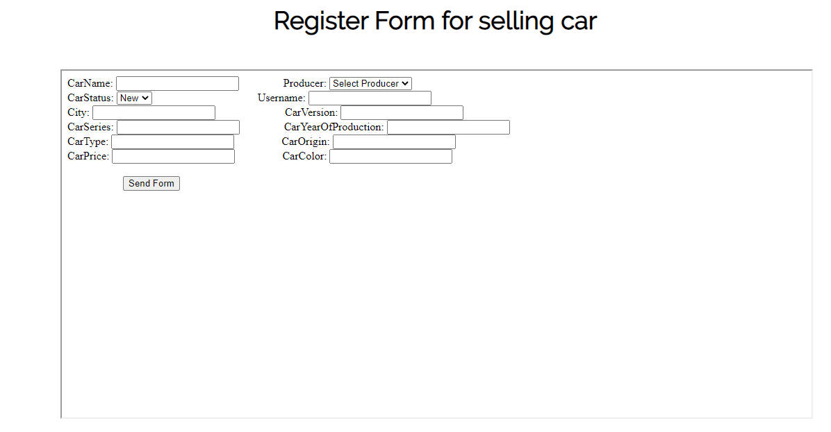
Selling Car Form

Slide 16
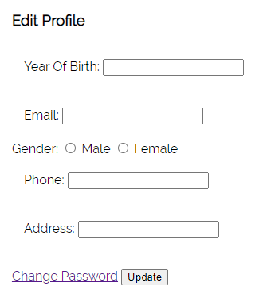
Edit Profile

Slide 17
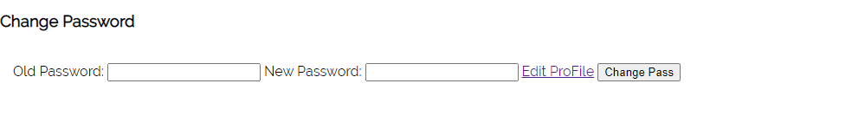
Change Password

Slide 18
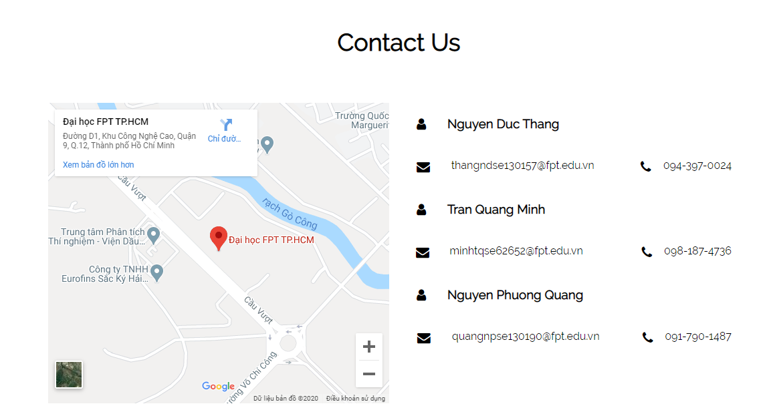
Contact

Slide 19
Admin Layout

Slide 20
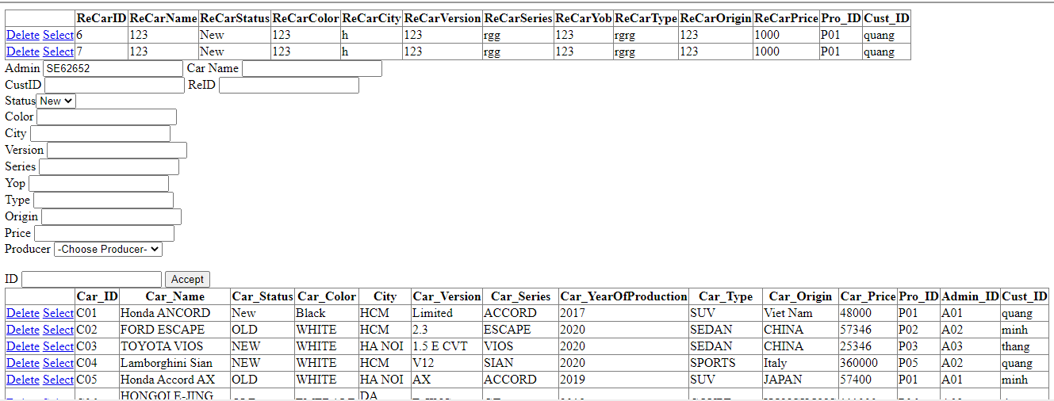
Manage Cars/Register Form

Slide 21
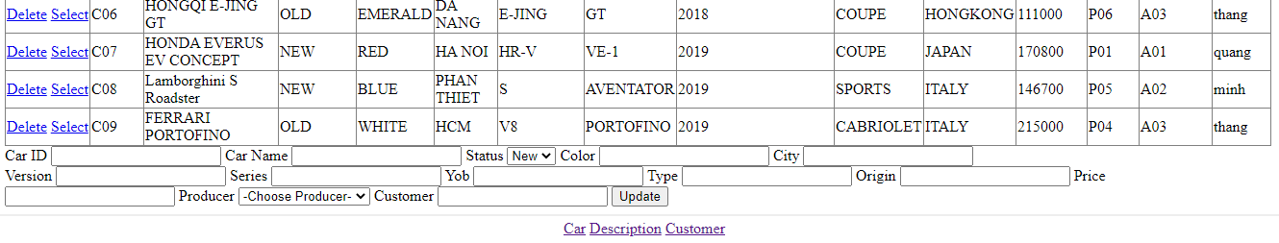
Manage Cars/Register Form

Slide 22
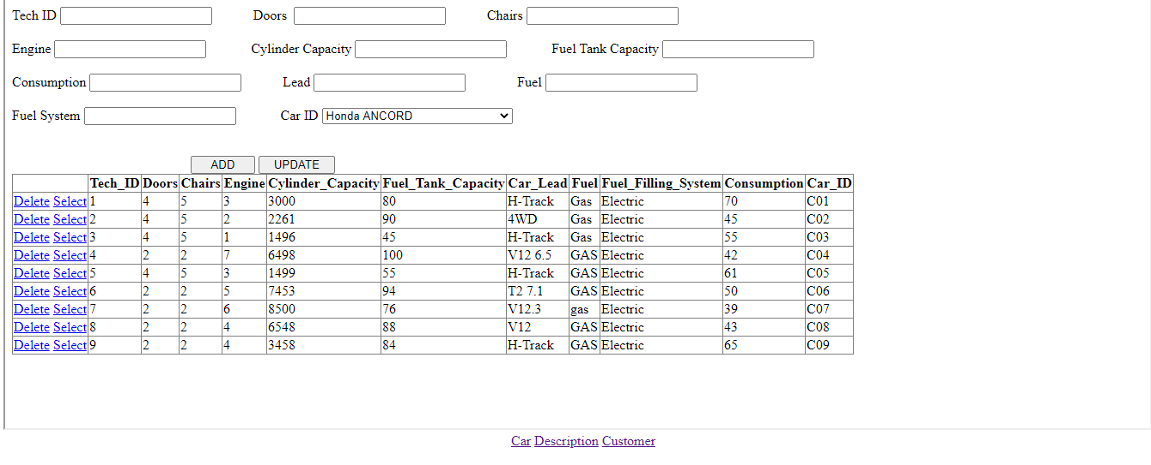
Manage Technologies

Slide 23
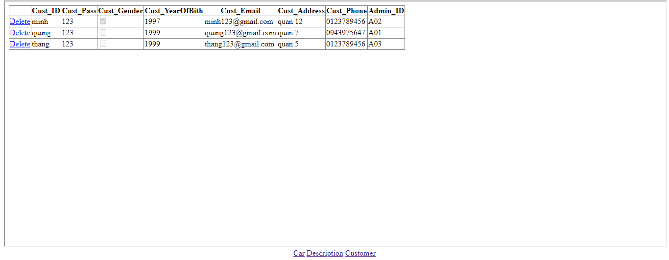
Delete Customer

Slide 24

Thanks for listening !!!

